Slide 1
Uncertainty Estimation in Discrete Time-to-Event models using Evidential Deep Learning
Revathy Venukuttan
Lab Meeting - Nov 8, 2024

Slide 2
SOTA for uncertainty estimation in discrete time-to-event models:
Bayesian Neural Networks for uncertainty estimation:
Y. K. Huh, M. Kim, K. Liu and S. Zhou, "An Integrated Uncertainty Quantification Model for Longitudinal and Time-to-Event Data," in IEEE Transactions on Automation Science and Engineering, doi: 10.1109/TASE.2024.3432400.
This paper uses a Bayesian Neural Network based Cox model
Survival analysis model:
P. Chapfuwa et al., "Calibration and Uncertainty in Neural Time-to-Event Modeling," in IEEE Transactions on Neural Networks and Learning Systems, vol. 34, no. 4, pp. 1666-1680, April 2023, doi: 10.1109/TNNLS.2020.3029631.
DRAFT (Deep Regularized Accelerated Failure Time Models) – semi parametric survival analysis model
Wu, Z., Yang, Y., Fasching, P.A., & Tresp, V. (2021). Uncertainty-Aware Time-to-Event Prediction using Deep Kernel Accelerated Failure Time Models. Machine Learning in Health Care.
This paper uses an Accelerated Failure Time (AFT) model – uses RNN for feature extraction and Gaussian process for time-to-event prediction
Paper similar to DeepHit: Katzman, J. L., Shaham, U., Cloninger, A., Bates, J., Jiang, T., & Kluger, Y. (2018). "DeepSurv: Personalized treatment recommender system using a Cox proportional hazards deep neural network." BMC Medical Research Methodology, 18(1), 24. (https://github.com/jaredleekatzman/DeepSurv)
Informative review article: https://arxiv.org/abs/2107.03342
Notes:
(DeepHit - Deep learning approach to Survival analysis)

Slide 3
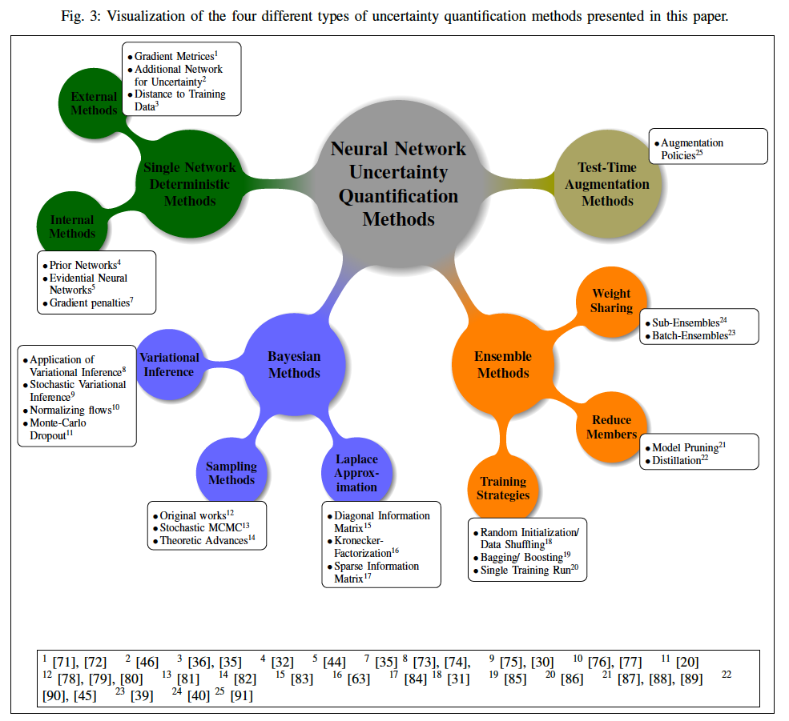
Source: arXiv:2107.03342

Slide 4
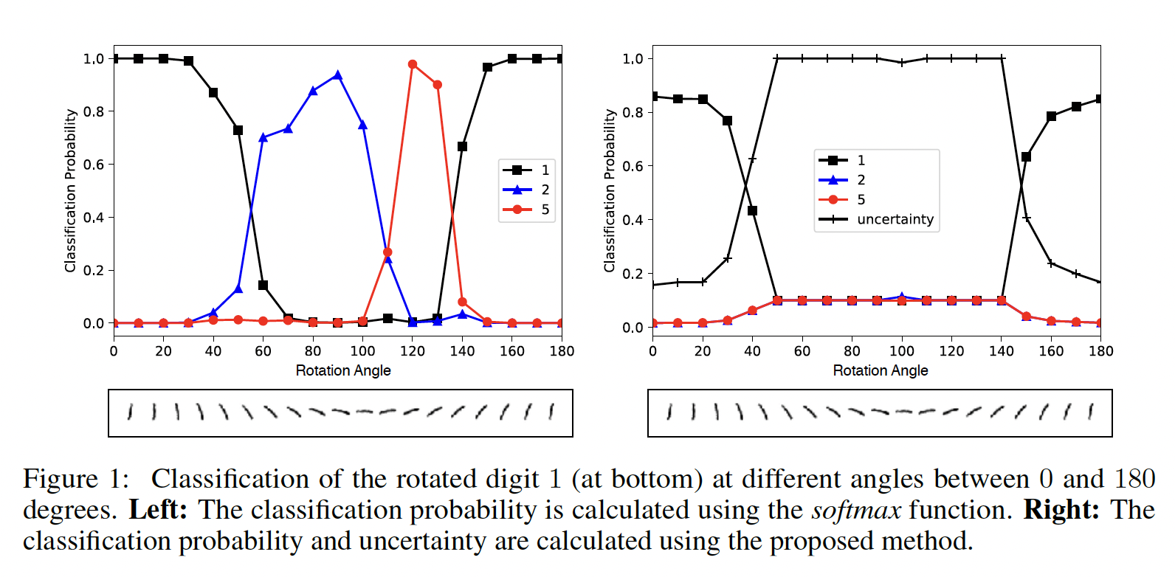
Quick summary of Evidential Deep Learning paper:
Uncertainty estimation from a Theory of Evidence perspective
Softmax output is replaced by parameters of a Dirichlet distribution
Uncertainty is inversely proportional to total evidence

Slide 5
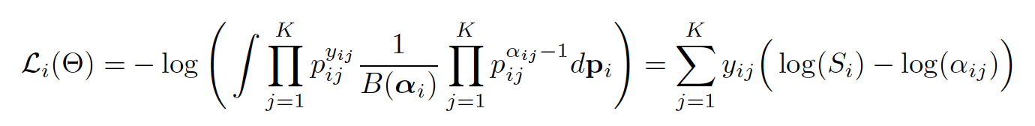
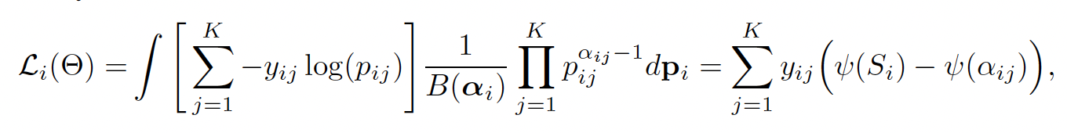
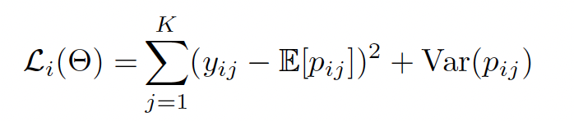
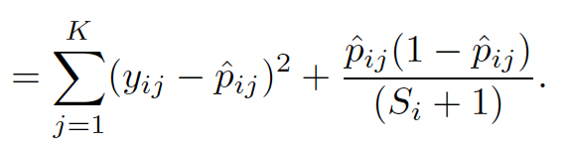
Quick summary of Evidential Deep Learning paper:
3 types of losses mentioned:
Type II Maximum Likelihood Loss:
Cross entropy loss with Bayes risk:
Mean Squared Error loss:

Slide 6
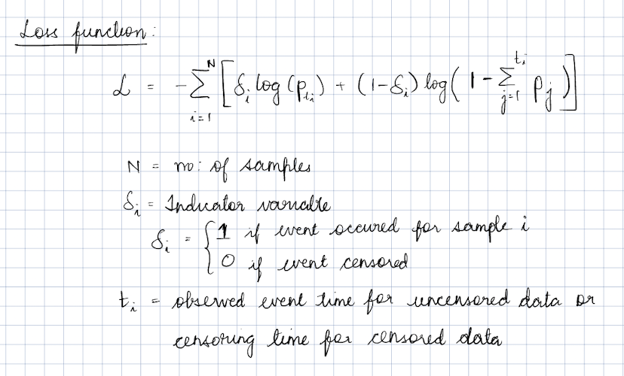
Modifying the Discrete Time-to-event model to output parameters for Dirichlet distribution
Step 1: Change the model output
Softmax layer replaced with activation layer. Eg: ReLU to ascertain non-negative output – taken as evidence vector for the predicted Dirichlet distribution
Step 2: Adjust the loss function
Loss function of a discrete time-to-event model is:

Slide 7
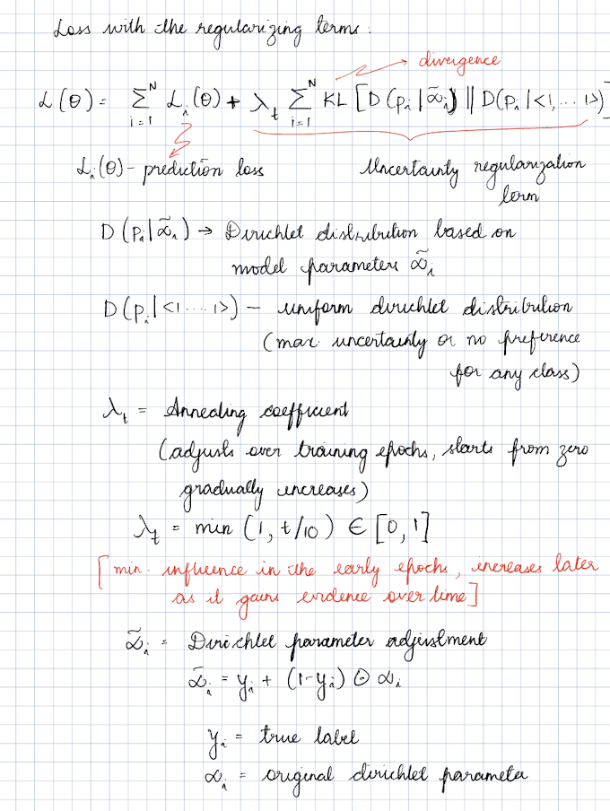
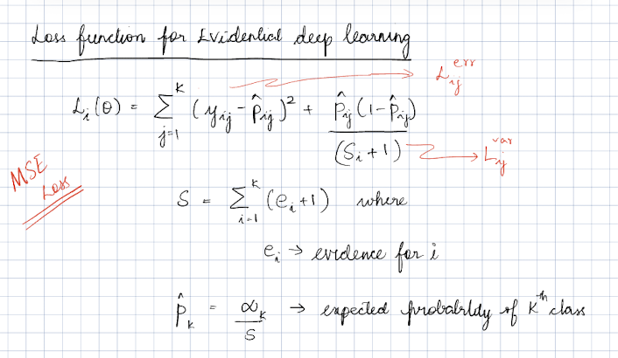
Loss function from EDL (MSE Loss):

Slide 8
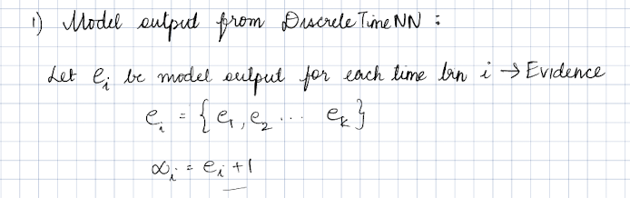
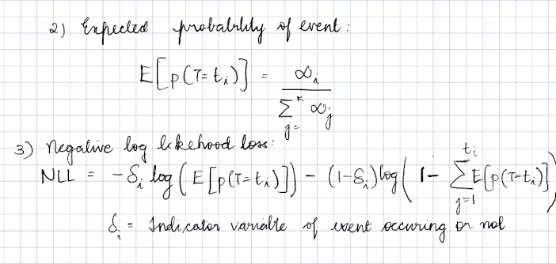
Combining both – Iteration 1 – with NLL loss

Slide 9
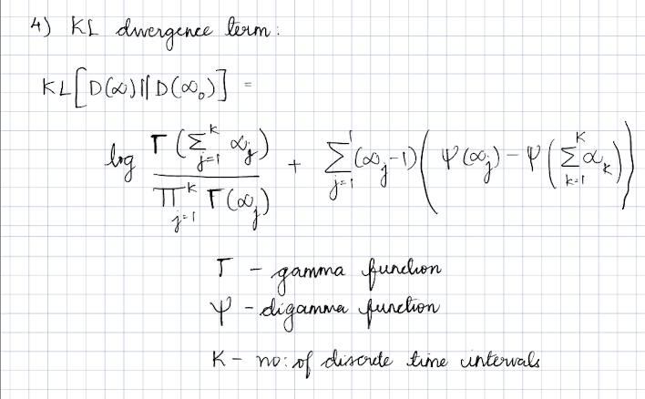
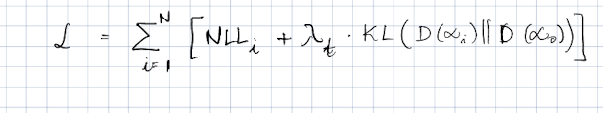
Combining both – Iteration 1 – with NLL loss
Total Loss:
Total loss:

Slide 10
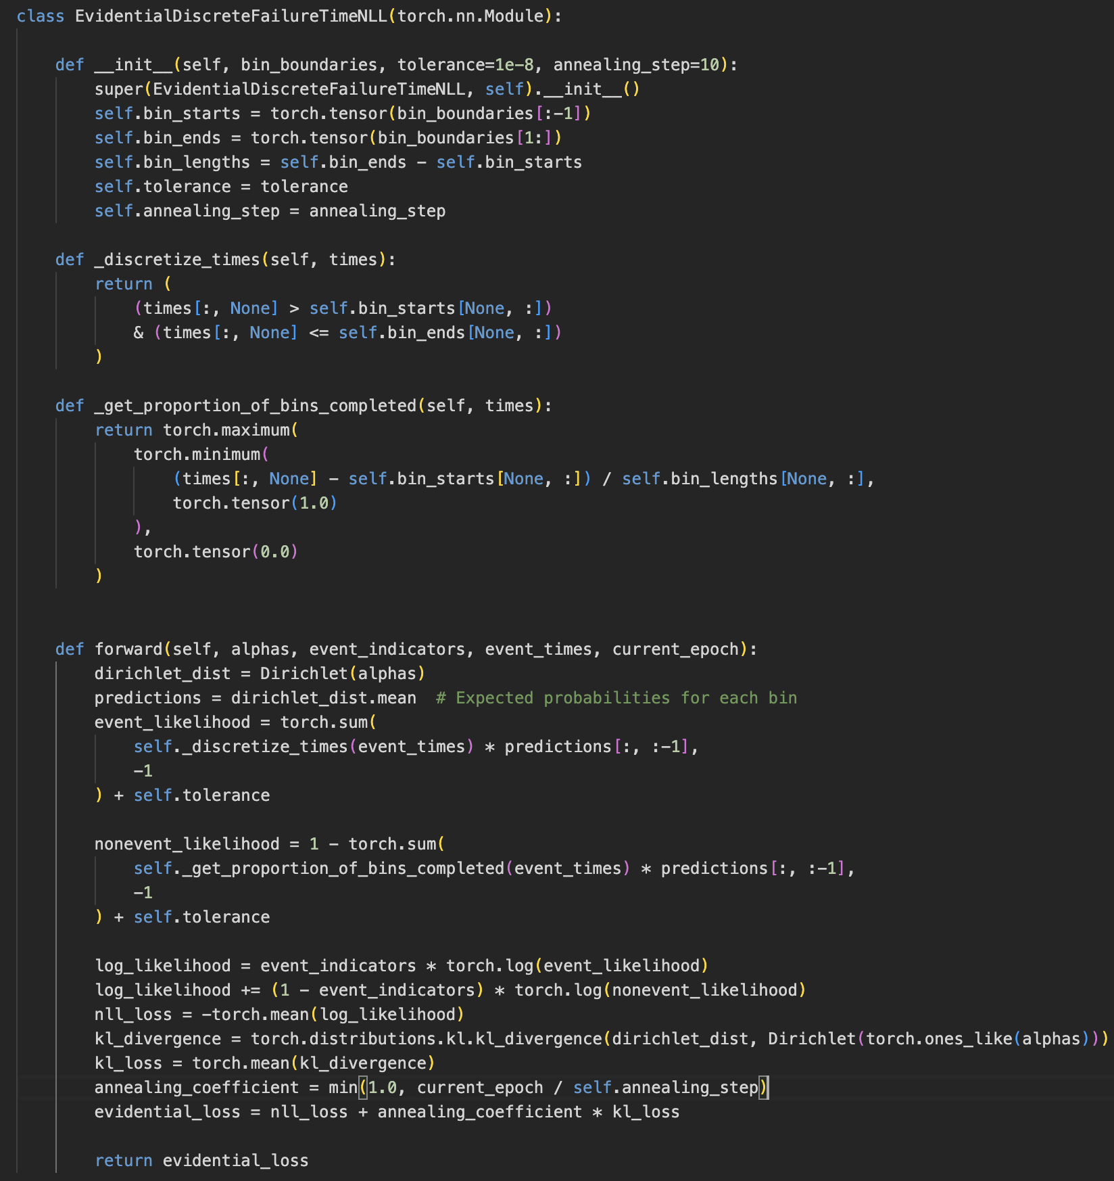
Implementation:
annealing_step = 10
Calculating kl_divergence – using torch.distribution.kl.kl_divergence (in-built PyTorch function)
Annealing coeff = min(1, current_epoch/annealing_step)
kl_loss = mean(kl_divergence)
Total loss = NLL_Loss + Annealing_Coeff * KL_loss

Slide 11
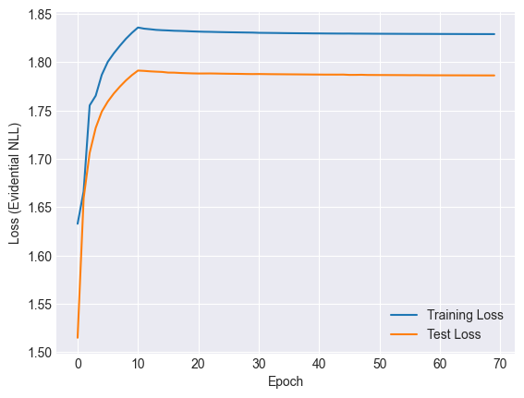
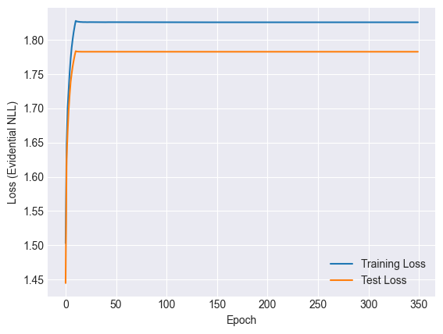
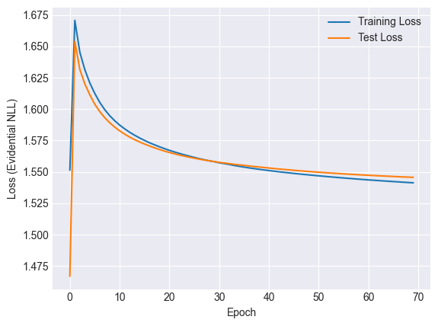
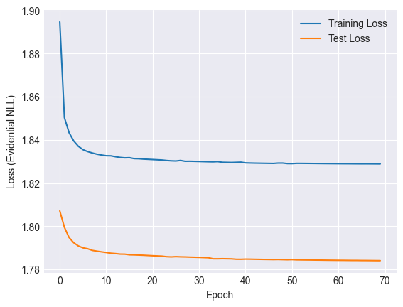
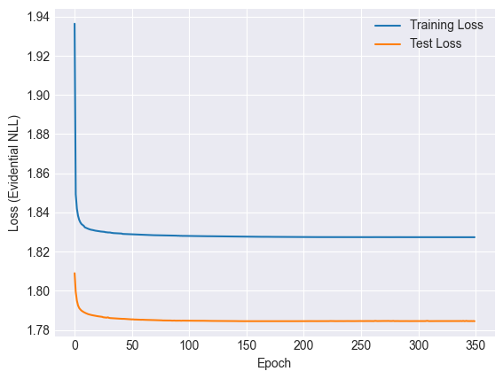
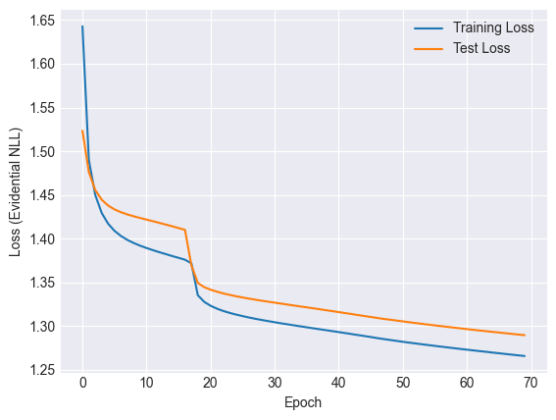
Loss versus epoch curves for various
Annealing coeff = min(1.0, t/10)
Loss = NLL_loss + Annealing_coeff *kl_loss
Num_of_epochs = 350
Loss = NLL_loss + Annealing_coeff *kl_loss
Annealing coeff = min(0.1, t/10)
Loss = NLL_loss + Annealing_coeff *kl_loss
Annealing coeff = min(1.0, t/10)
Loss = NLL_loss + kl_loss
Num_of_epoch = 350
Loss = NLL_loss + kl_loss
Loss = NLL loss

Slide 12
Next steps:
Use the MSE loss in the Discrete time-to-event model setting
Explore the other 2 losses mentioned in the paper

Slide 13
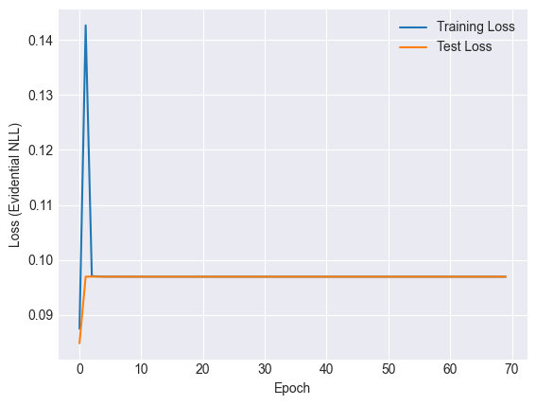
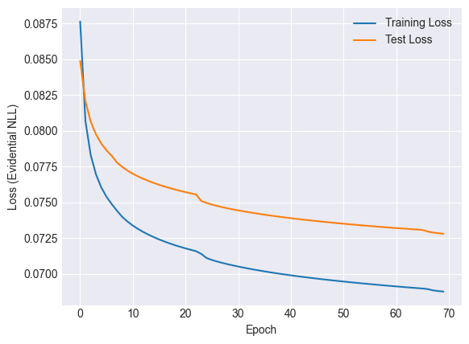
Iteration 2: MSE loss from EDL paper
Loss with the KL regularization
Loss function without the KL term

Slide 14
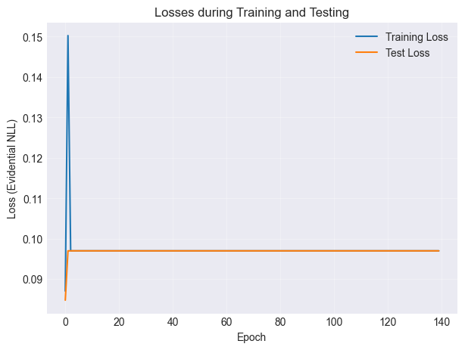
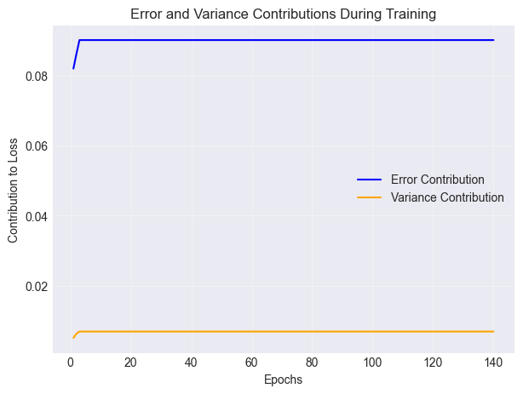
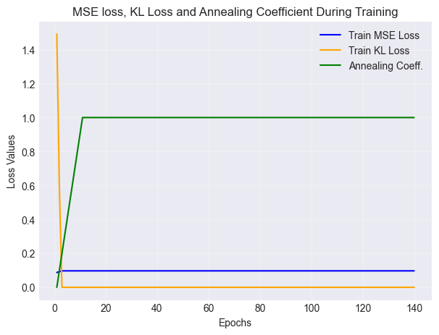
Loss without censoring – plotting all parameters
Loss = MSE loss + Annealing coeff*KL loss

Slide 15
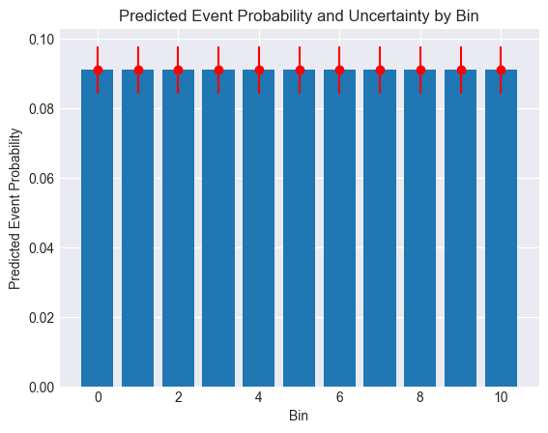
Test data for random samples
All test data

Slide 16
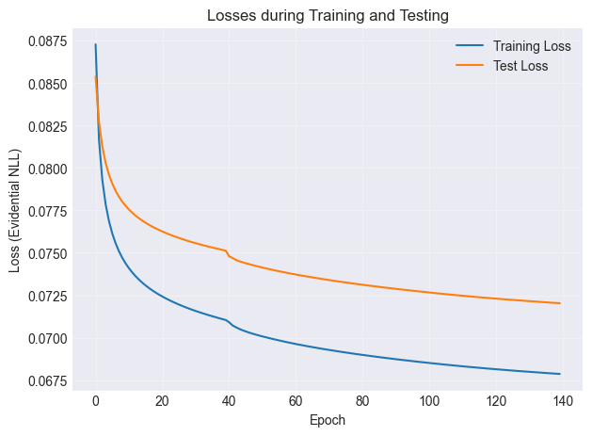
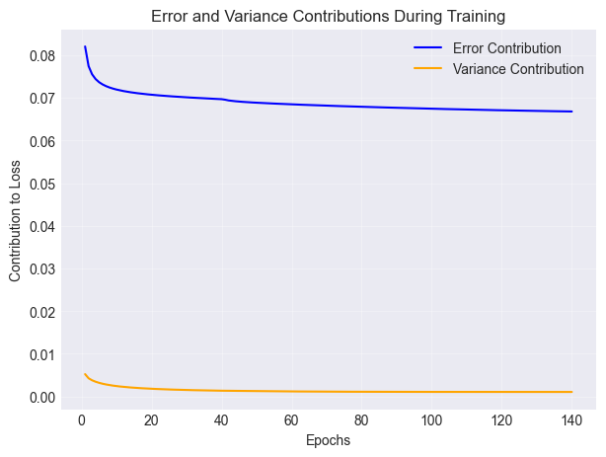
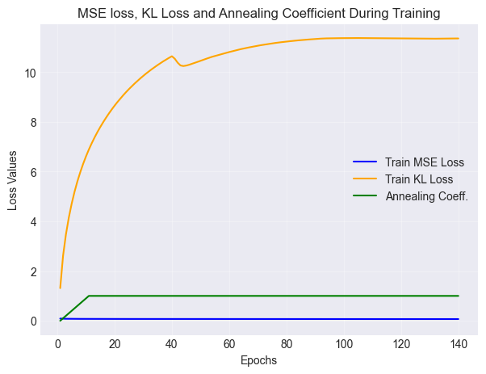
Loss without censoring – plotting all parameters
Loss = MSE loss

Slide 17
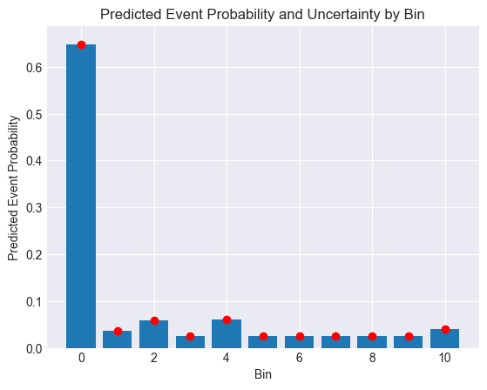
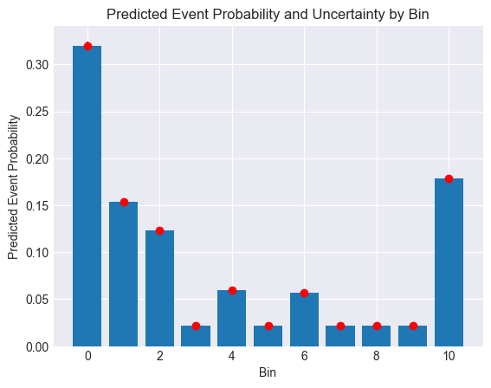
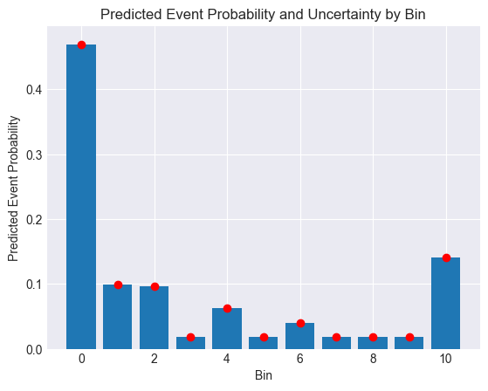
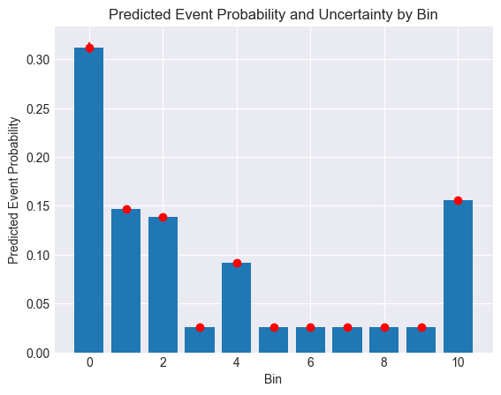
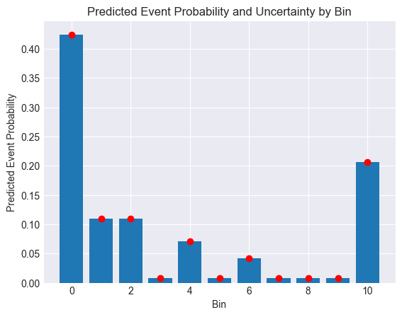
Test data for random samples
All test data

Slide 18
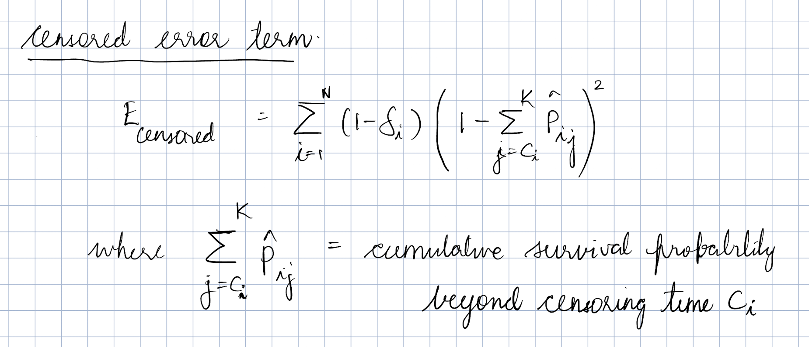
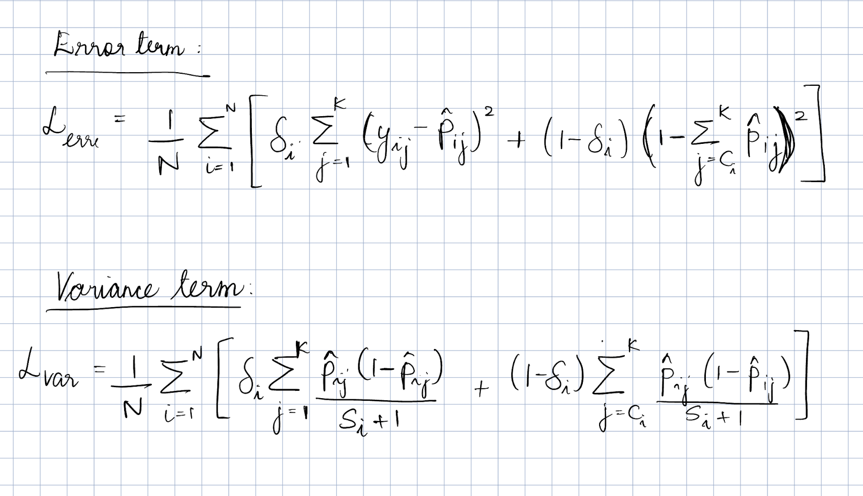
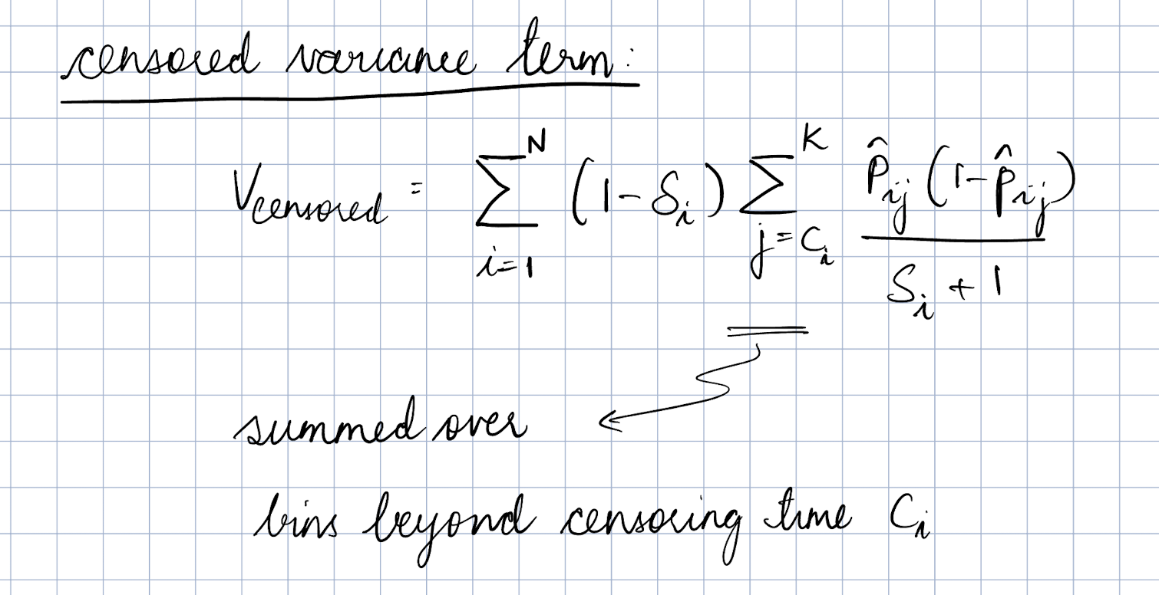
Modifications made to loss equation
Notes:
In case of censoring, collapse distribution to bernoulli

Slide 19
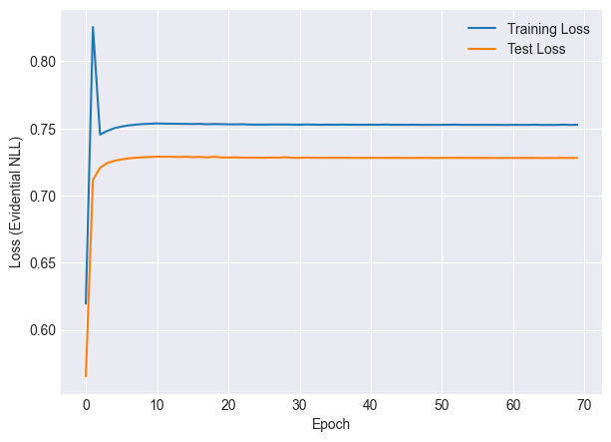

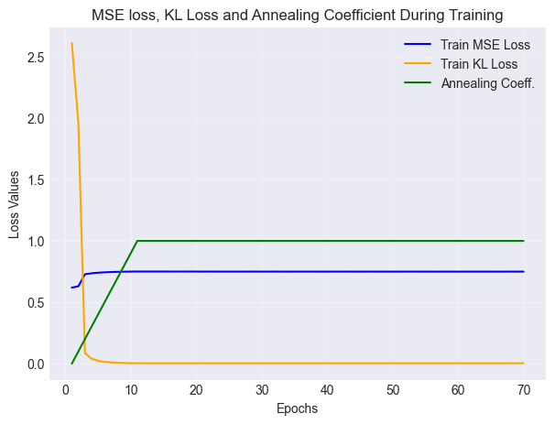
Loss with censoring – plotting all parameters
Loss = MSE loss + Annealing coeff*KL loss

Slide 20
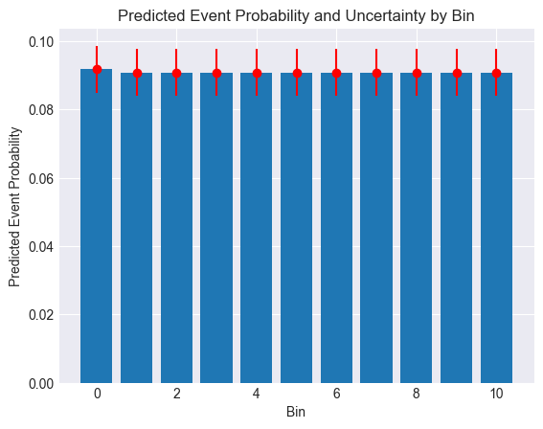
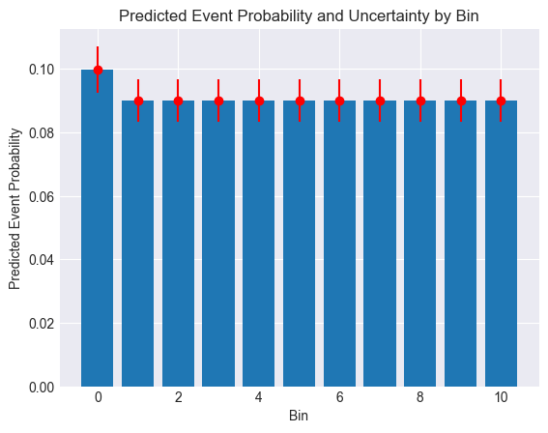
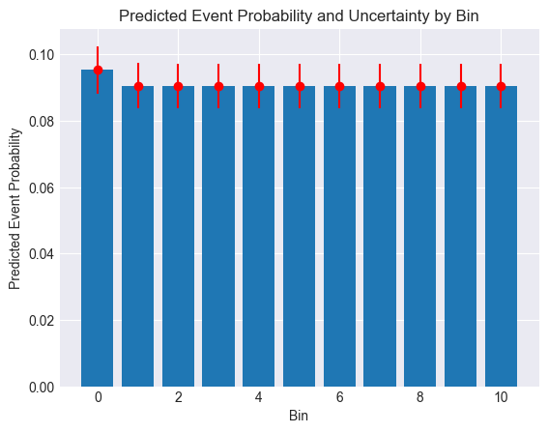

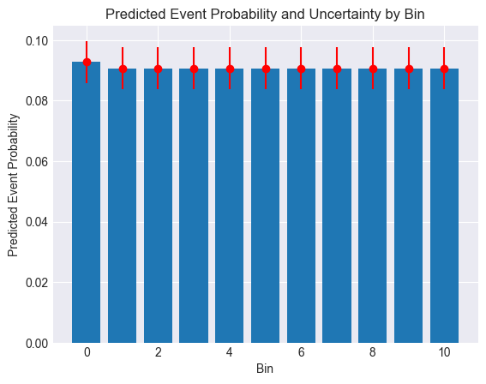
Test data for random samples
All test data

Slide 21
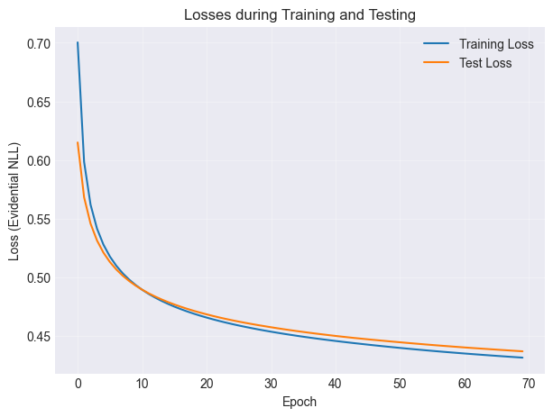
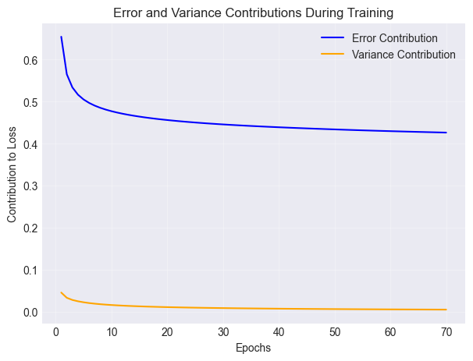
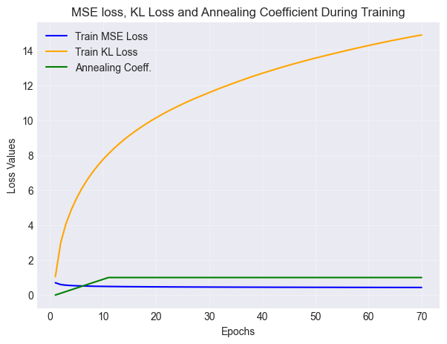
Loss with censoring – plotting all parameters
Loss = MSE loss

Slide 22
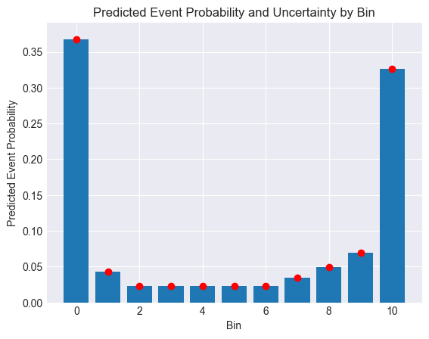
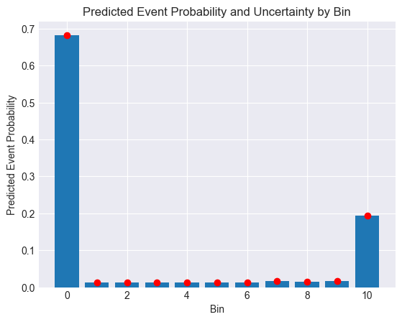
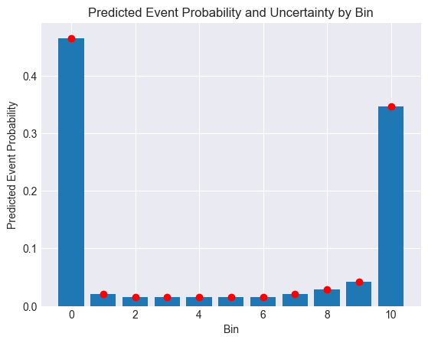
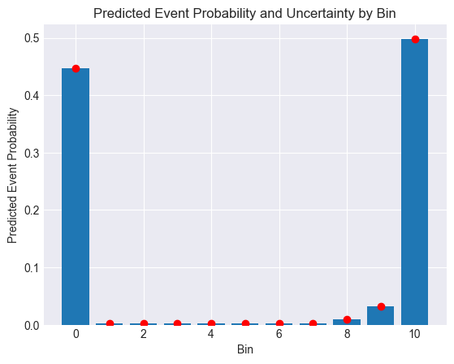

Test data for random samples
All test data

Slide 23




Loss functions with censoring after correction:
Loss = MSE_loss + annealing_coeff * KL_loss
Error and variance correction for censored samples

Slide 24


Predicted Event Probability
Random samples from test data
All test data

Slide 25


AUC curves – comparison with baseline model that has NLL loss function
Model with EDL (MSE loss + annealing_coeff * KL_Loss)
Model without EDL (NLL_Loss)

Slide 26






KL regularization term adjustments
1. Iteration 1: Adjusting the annealing coefficient – adjusting the annealing_step
Annealing coeff = min(0.1, current_epoch / (2 * annealing_step)); annealing_step = 10

Slide 27






KL regularization term adjustments
2. Iteration 2: Adjusting the annealing coefficient (gradual increase in KL weight)
Annealing coeff = min(1, current_epoch/(total_epochs/2))

Slide 28






KL regularization term adjustments
3. Iteration 3: Adding an additional scaling parameter for KL – lambda_kl with lambda_kl = 0.1
Evidential loss = MSE_loss + annealing_coeff * lambda_kl * KL_loss

Slide 29






KL regularization term adjustments
4. Iteration 4: Adjusting the annealing coefficient (loss-based annealing coeff.)
Annealing coeff = kl_loss / (mse_loss + kl_loss)

Slide 30






KL regularization term adjustments
5. Iteration 5: Normalize the KL term by the number of bins
KL_normalized = KL_loss/number of bins
Evidential_loss = MSE_Loss + annealing_coeff * KL_normalized

Slide 31



Loss functions with censoring after correction:
Loss = MSE_loss

Slide 32



Predicted Event Probability
All test data
For random samples from the test data

Slide 33

AUC curves for the model without the KL divergence term in Loss function

Slide 34




Slide 35



Random test samples
All test data

Slide 36

AUC curves

Slide 37
Key takeaways from DeepHit:
Learns joint distribution of survival times and events directly
No assumptions about underlying stochastic process
Allows for possibility that the relationship between covariates and risk change over time
Handles competing risk
Model:
Single softmax layer as output layer
Shared sub-network layer -> cause specific sub networks
Maintain residual connection from the input covariates into input of each cause specific sub network
Output from softmax is a probability distribution
Loss function:
2 components –
- log likelihood of joint distribution of first hitting time and event
- combination of cause specific ranking loss function

